Slide 1
Computer Graphics
Enhanced Texturing & Clipping

Slide 2
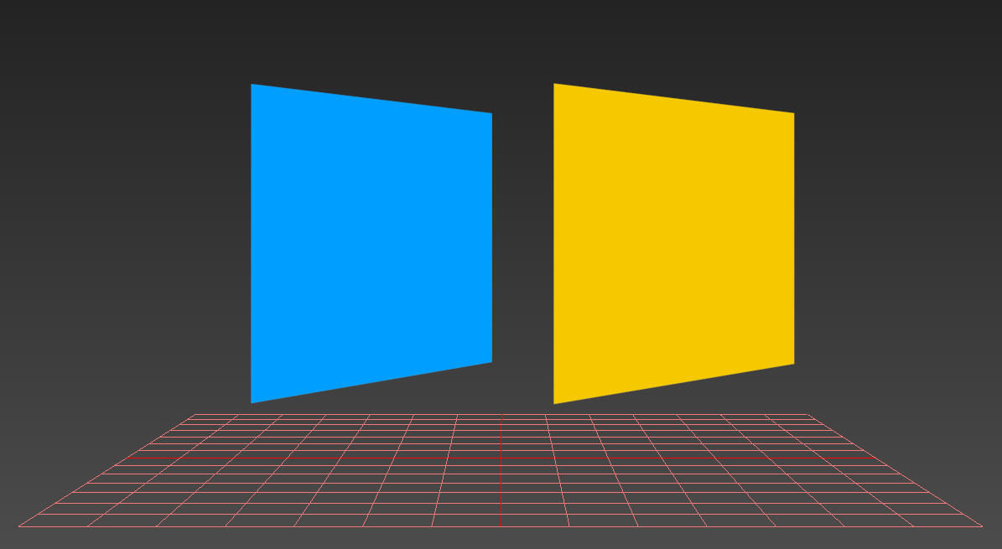
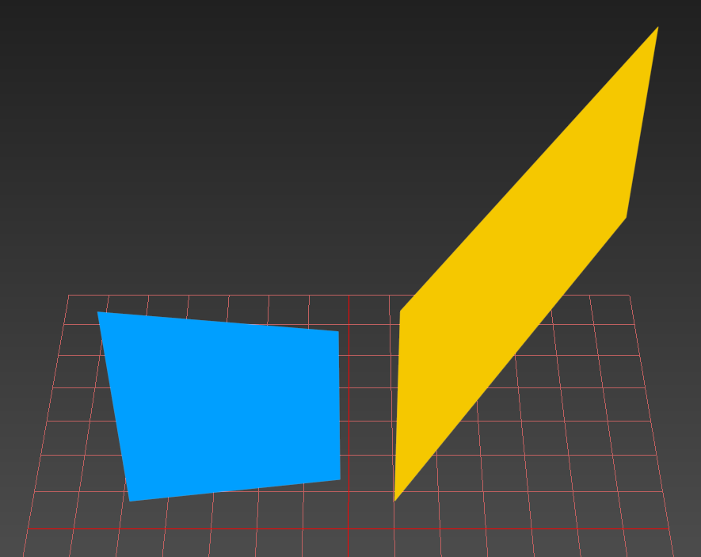
Two Identical Shapes… Or Not…
Seen From Above

Slide 3
So What Is The Big Deal?
If your shapes are only solid colors, then it probably doesn’t matter…
However, this can have a huge impact anytime you want to have varying visual information across the surface of a primitive.
Recall that when rasterizing 3D objects we send our vertex data through the perspective matrix and then apply the perspective divide.
This “squishes” geometry farther from us to create perspective when drawing our shapes.
When it comes time to interpolate things such as Color & UV data we simply assume everything is in a linear 2D space ignoring any changes in Z.

Slide 4
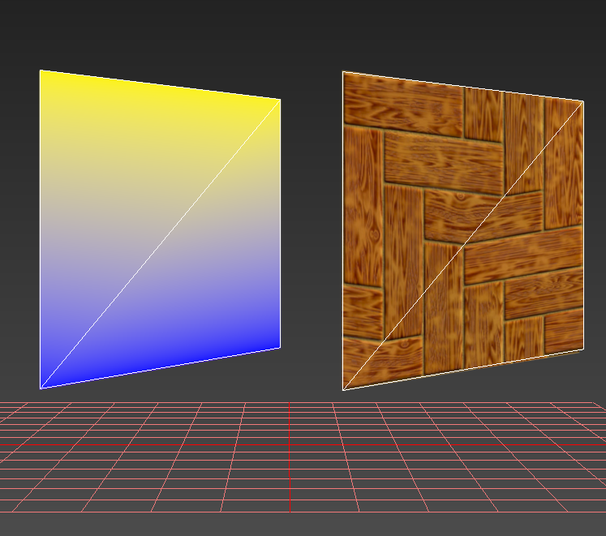
Screen/NDC Space Interpolation
A.K.A “Affine” Interpolation, this what we have been doing.
By ignoring Z values we assume the triangle is parallel to the viewing plane (flat!) and interpolate linearly across the surface of the triangle.
Though not as noticeable for colors, it can be very jarring for textures.
Notice how it preserves parallel lines relative to the space of each triangle.

Slide 5


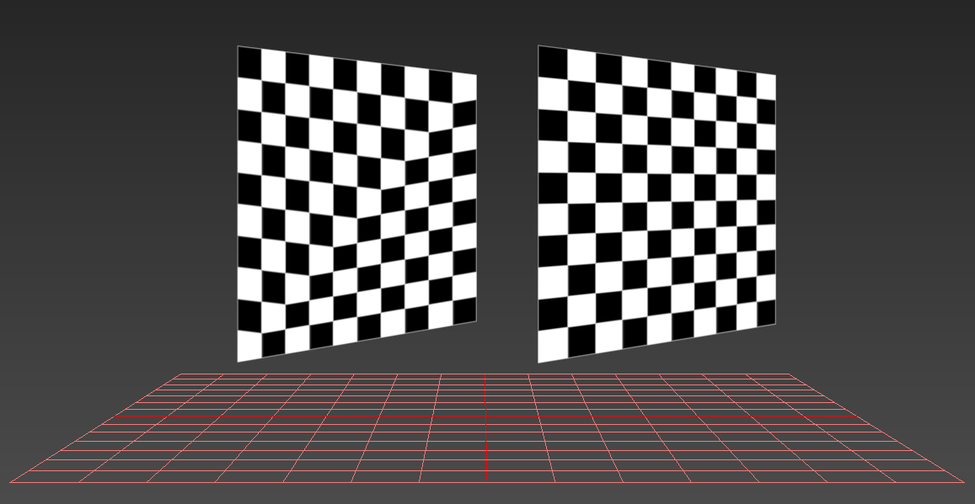
Affine Vs. Perspective Correct Interpolation

Slide 6
Why does this happen?
The data we wish to interpolate was defined for primitives created in an orthogonal 3D space. (Local Space)
After the perspective divide, parallel lines are not preserved. (that’s the point!) Primitives in screen space have already been “squashed”.
Interpolation for both lines & triangles is a linear operation. This means you are doing a linear interpolation on linear data (Colors, UVs) in the space of a triangle that is NOT supposed to be ORTHOGONAL.

Slide 7
How can we fix this?
Recall that your vertex Shader has already modified your position data to have perspective applied right before Rasterization.
This was done by dividing XYZ by the W component immediately after applying the projection matrix.
Remember that the W component is actually the “preserved” original linear Z!
Our current problem is that the other values we want to interpolate do not take perspective into account. (Ex: Any extra data on the vertices)
If we already know how to add perspective to XY positions, we can also “squish” data like UVs and Colors using the same method!
The key to perspective is being able to divide by the linear Z. So if we can find the “Z” of a specific COLOR or UV then we can “squish” it properly just like we did the position!

Slide 8
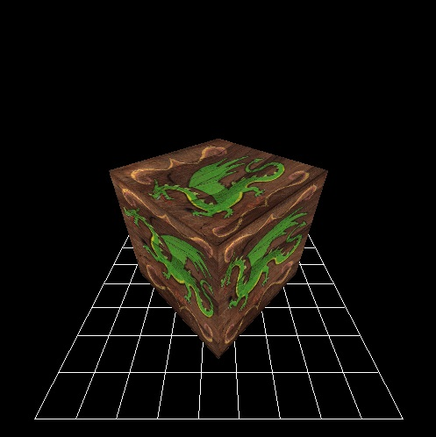
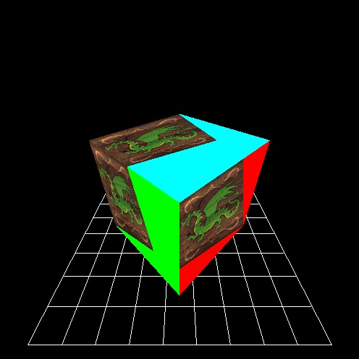
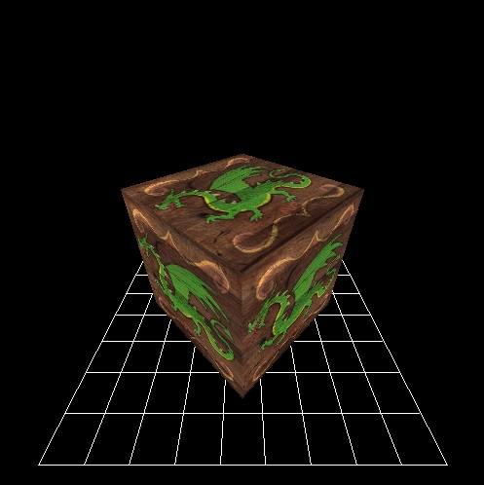
Adjusting Interpolation For Perspective
AFFINE
UV DIVIDED BY Z
UN-SQUISHED

Slide 9
Perspective Correct Interpolation Algorithm:
Step 1: During Rasterization, find the RECIPROCAL of the LINEAR Z of each VERTEX. Interpolate these values in their Reciprocal form.
If you are using a linear depth buffer you should already have some of this.
Step 2: Take whatever you want to interpolate (ex: Color, UVs) and DIVIDE it by the LINEAR Z of the VERTEX. Do this FOR EACH vertex’s data.
Doing this applies the proper amount of perspective based on the vertex depth.
Step 3: Interpolate the “adjusted” values as you normally would.
Step 4: Before using the interpolated data DIVIDE it by the interpolated RECIPROCAL LINEAR Z of the Pixel (step 1). This will rescale (un-squish) the data to fit the primitive.

Slide 10
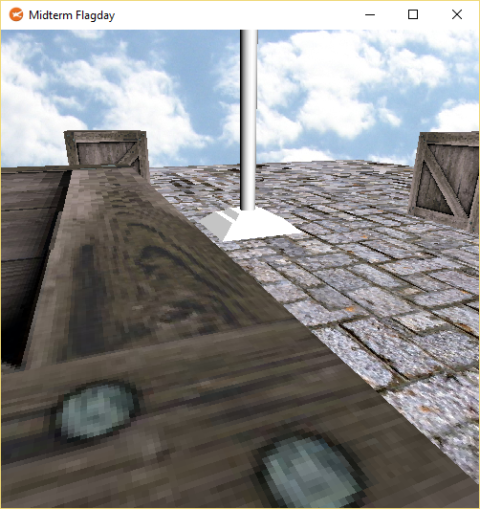
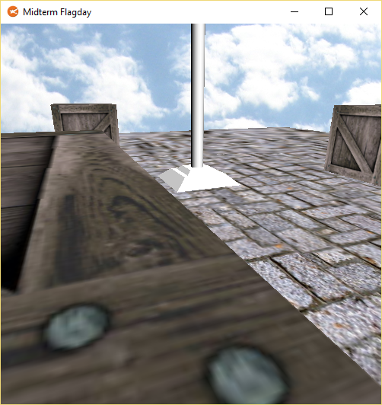

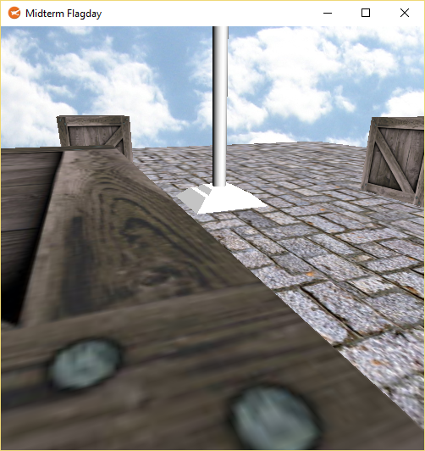
Improving Texture Quality During Rasterization
NEAREST
BILINEAR
TRILINEAR
ANISOTROPIC

Slide 11
Texture Filtering
Texture Coordinates are in terms of Ratios.
A “Texel” does not necessarily fall exactly on top of a specific pixel.
This means that the color a screen pixel displays could actually be a mix of values from a texture.
There are two basic ways to compute this color value.
After we discuss MipMapping this will expand to four ways.

Slide 12
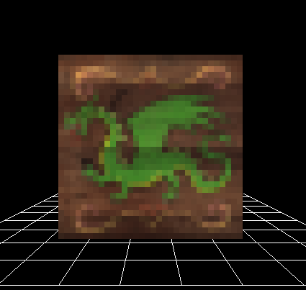
Nearest Texture Filter
A.K.A Nearest Neighbor / Point Filtering, this method simply rounds the Texel to the closest pixel on the texture and uses that color.
If your texture is much lower resolution than the rasterized primitive it will create a very “8bit” / “Blocky” style appearance.
If the texture is much higher resolution than the primitive it can create a very “shimmering/grainy” effect as colors quickly jump from one to the next.
This method is very cheap & fast, many PlayStation era games used this technique.

Slide 13
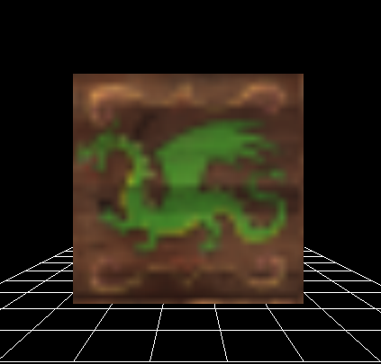
Bi-Linear Texture Filter
This filter looks at the four pixels closest to a Texel. It then determines what percentage each pixel contributes to the final color.
This creates a softer look on low resolution images that must be scaled up to fill more screen real-estate.
The Nintendo N64 was one of the first home consoles to support Bi-Linear and Tri-Linear texture filtering.
This technique is very common in modern computer graphics. The other filters we discuss later are evolutions of this basic filter.

Slide 14
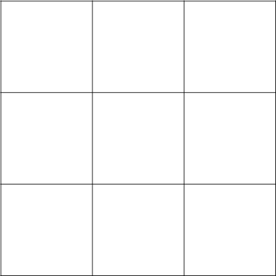
Implementing a Bi-Linear Texture Filter
0.25u 0.25v
25 : 75
25 : 75
25 : 75

Slide 15
MipMapping
When there are too few Texels to Pixels on screen, Bi-Linear filtering can compensate for some loss of detail. (Magnification)
Unfortunately this does not remedy the opposite situation where the correct pixels cannot be decided effectively and shimmering occurs. (Minification)
The solution is to preprocess smaller versions of the texture that can be swapped in based on distance to reduce shimmering artifacts.

Slide 16
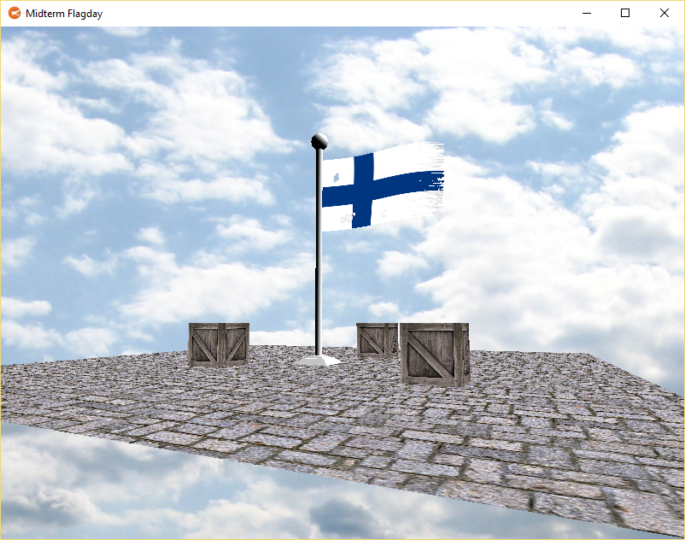
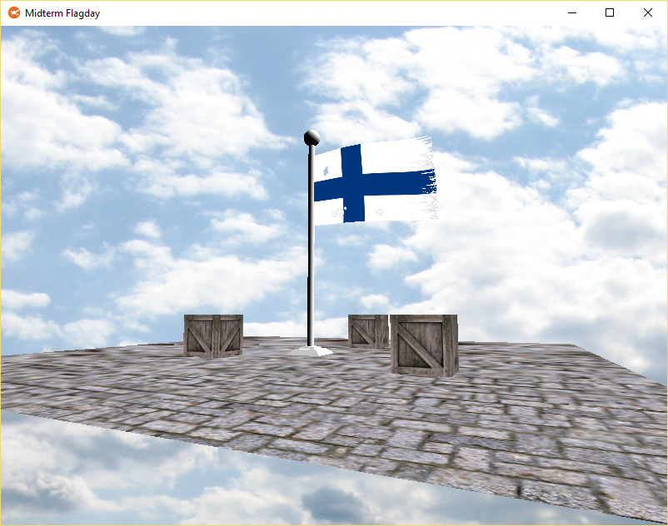
MipMaps: Improving SNR
Without MipMapping
With MipMapping

Slide 17
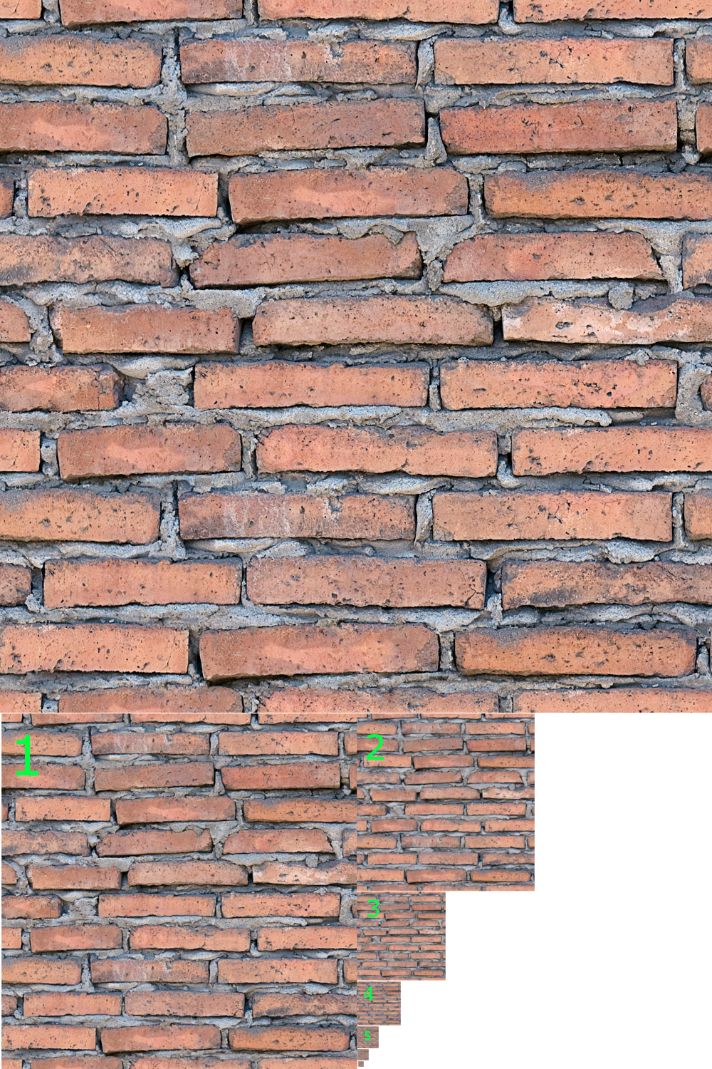
Building a Mip Chain
For each 2x2 block of pixels in the original image average the resulting color and write one pixel in the next level.
Repeat the process (recursive) for each new level until you have blended the image down to a single pixel.

Slide 18
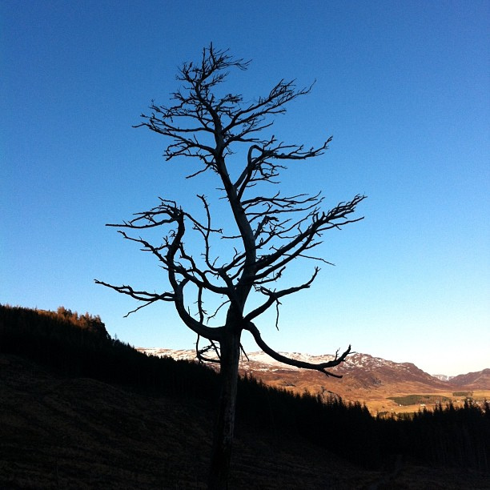
Naïve Mip-Level Selection
F
A simple way to select a mip-map level is just to look at the depth value of your Z.
Convert the pixel’s Z to a Ratio between the near & far plane and then select the Mip-map based on that Ratio.
While certainly a basic solution it may look “good enough” depending on your visual requirements.
Modern Hardware certainly does not use this method.(That’s a good thing)
N
?
Pz - N
Level =
*
NUM_LEVELS
F - N

Slide 19
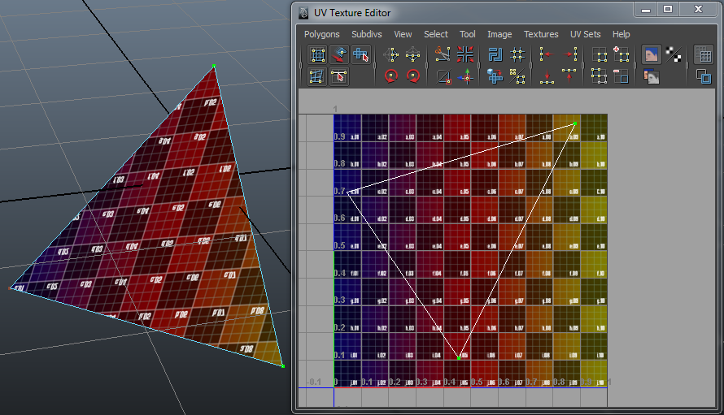
DU/DV Mip-Level Selection
Looks at the change in U and V along the edge of a primitive.
Based on this Delta, a Texel to Screen Pixel Ratio is computed.
These ratios then help choose the appropriate mip-map level that will bring the ratio closest to 1:1
This is significantly more accurate than the Naïve method.
ΔXY
ΔUV * WH
ΔXY
ΔUV * WH
ΔUV * WH
ΔXY
https://www.gamedeveloper.com/programming/run-time-mip-map-filtering

Slide 20
Tri-Linear Texture Filter
This is actually pretty simple.
Basic mip-mapping only chooses the closest mip-level based on a depth ratio.
For example 2.75 would truncate to just level 2.
Tri-Linear uses this discrepancy to improve texture accuracy by combining two bilinear filters.
In the above example a tri-linear filter would bi-linear filter both levels 2 & 3. Then it would use 75% of the level 3 filter and 25% of the level 2 filter.
This improves texture quality & transitions across the Z axis.
One Mip Level Per-Pixel
Two Levels Blended Per-Pixel
BILINEAR
TRILINEAR

Slide 21
Anisotropic Texture Filter
Projection ignored during filtering
Projection applied during filtering
Very expensive to do without dedicated graphics hardware.
Essentially Anisotropic utilizes the perspective divide discussed earlier to make even the texture filtering process adhere to our Non-Orthogonal primitive space.
This means even texture filtering will now be “Perspective Correct”
TRILINEAR
ANISOTROPIC 2X

Slide 22
Primitive Clipping for Rasterizers

Slide 23
Clipping 3D Points
Clipping points is fairly straightforward as you might imagine.
NDC is a solid space to clip in because it has fixed known limits. (-1 to +1)
You can also wait till screen space to do this, many of you may already be doing this in some capacity.
Don’t forget to also test a point if it is closer than the near plane in 3D since it should be hidden.
Note that points with negative Z values cause the X & Y to flip during the perspective divide. Not a seemingly big deal for 3D points, however…

Slide 24
The problem with waiting till NDC to clip lines & triangles
F
+Y
Uh-oh...
There are two key issues here:
First by having Z values less than N we create the possibility of dividing by Zero. (xyz/w)
Second, if a W (original Z) value is LESS than Zero then the perspective divide will cause the X & Y components to flip!
While this may not seem troublesome for points, it will completely re-shape lines & triangles which straddle the Zero plane!
N
0
-Z
+Z
-Y

Slide 25
Clipping 3D Lines
As you saw in the last slide, waiting till NDC is just too late for dealing with lines or triangles for that matter.
A solution to this problem is to clip BEFORE the perspective divide. However, clipping in spaces other than NDC can seem daunting since the frustum is not as easily defined.
However: Note that in homogenous projection space, view space values at the Near plane have actually been shifted to Zero. (Do the math, see for yourself!)
This makes clipping at least against the Near plane itself a breeze in projection space.
Once we have successfully cut our lines along the Near plane we can then safely apply perspective without worrying about an X & Y sign flip for negative Z values.
Once our lines are safely back in NDC we can continue with straightforward 2D clipping.

Slide 26
Clipping a Projection Space line against the Near Plane
F-N
+Y
This is actually pretty easy if you understand the Parametric Line Equation.
If an end point is behind the near plane, we can determine how far by simply looking at it’s Z.
We then can divide this Z delta by the Z delta of the entire line.
This yields a ratio of how far the line has penetrated the Near plane.
You can then use linear interpolation to compute a new vertex intersecting the plane.
ΔPZ
B
0
-Z
C
+Z
ΔZ
A
ΔZ
C
= Lerp ( , , )
-Y
A
B
ΔPZ

Slide 27
Clipping 2D Lines
A
ΔPY
ΔY
Once the lines have been clipped to the near plane we can safely bring them into NDC and use the same technique to clip them to the edges of the screen.
I suggest making your life easier by checking if lines are completely inside or outside the frustum before attempting to clip them.
This is easily done by checking both endpoints against the various clipping planes.
+1Y
C
-1X
+1X
B
-1Y
ΔY
C
= Lerp ( , , )
A
B
ΔPY

Slide 28
Clipping 3D Triangles
This sounds tough, but the good news is that we can apply what we learned about lines to help deal with triangles intersecting the near plane.
Once again use early plane tests to fully accept or reject triangles that you know will not intersect the near plane.
Just like 3D lines, we must first clip triangles to the Near plane before we can concern ourselves with clipping them to our 2D device.
This too must be done in homogenous projection space before the perspective divide.
There are two key scenarios you must deal with when clipping triangles…

Slide 29
Scenario 1: Interpolating From The Hidden Edge
+Y
C
IC
In this scenario, two of the three vertices are piercing the Near plane.
This is the simpler of the two scenarios to deal with.
Take the two hidden vertices and interpolate them to the opposite point across the plane.
Use the exact same technique you used for your lines, in fact you can probably re-use your existing function to intersect the offending edges.
THE HIDDEN EDGE
B
IA
-Z
0
+Z
A
-Y

Slide 30
Scenario 2: Interpolating To The Visible Edge
+Y
C
In this scenario, only one of the three vertices are piercing the Near plane.
This time take the hidden vertex, split/copy it and interpolate to the opposite points across the plane.
This one is a bit trickier because the remaining shape is a quadrilateral.
Rather than writing a whole new rasterization routine, we can split the shape into two distinct triangles.
Take care to keep the original winding order of the triangle.
ID
THE VISIBLE EDGE
-Z
0
+Z
B, D
IB
A
-Y

Slide 31
Clipping 2D Triangles
Thankfully this last part is very easy. Instead of trying to further clip the triangles in NDC, lets just have the triangle drawing routine handle this!
For example: The better brute triangle algorithm already creates a bounding box around the triangle.
Just take this Box and clamp it to the edges of the screen in pixel space.
Faster triangle drawing routines can also benefit from similar approaches!

Slide 32
Programming Tips
You don’t need to adjust your pixel shader for perspective correct interpolation. Pixel shaders are designed to accept already interpolated values.
You WILL need to adjust your pixel shader for enhanced texture filtering.
By ignoring pixels rasterized off-screen you can implement VERY slow 2D clipping, but it won’t save you from errors created by vertices with negative Z values. (3D Clipping)
Make your Near Plane line clipping function return result codes: 0 for hidden, 1 for in front of Near Plane and 2 for a line that was clipped. These codes will help you figure out what to do when clipping triangles. (test the 3 lines)
The vertex shader can no longer apply the perspective divide. You must allow the clipper to have access to Homogenous Projection Space coordinates. (do it later)

Slide 33
Applicable Reading Assignment
For next time read:
In Chapter 10 Surface Shading:
ALL
In Chapter 18 Using Graphics Hardware:
ALL

